Slide 1
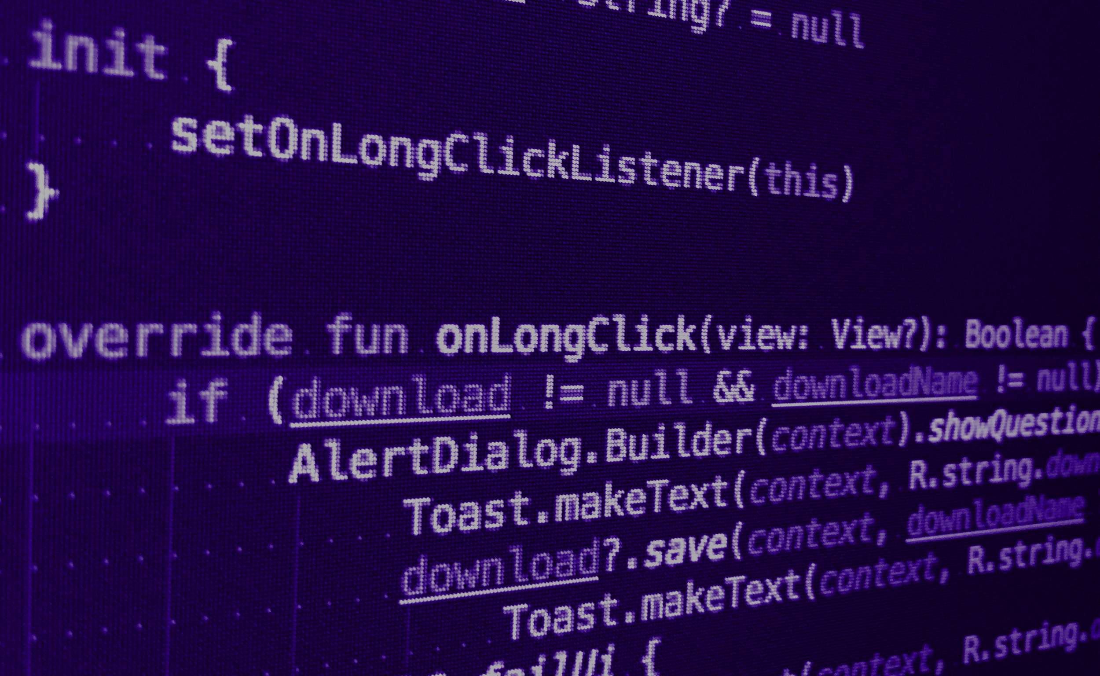



Git & CI/CD
CPE -2021

Slide 2



Alexandre Nunesse
anunesse@takima.fr
Benjamin Legros
blegros@takima.fr
Loic Ortola
lortola@takima.fr

Slide 3
Planning
Lundi 01/02
Mardi 02/02
Mercredi 03/02
Jeudi 04/02
AM
Cours
Cours
Cours
TD 1
TD 2
TD 3
PM
TP 1
TP 2
TP 3
TP finish
+
Extras
Surprise 🤯🤕
Jeudi 11/02
Exam
Notes:
A CHANGER SELON LA CONF DE LOIC

Slide 4
Git

Slide 5
Git
GIT is a VCS but what is a VCS?
Veritas Cluster Server, a commercial high-availability computer clustering system
Version Control System, a system for managing multiple revisions
Venture CapitalS, specials investment funds
Vietnamese Council of State, the highest standing body of the National Assembly of Vietnam
Operations

Slide 6
Git
When is GIT born?
1998, Hugo Chávez is elected President of Venezuela
2002, Salt Lake city winter olympic games
2005, Pope John Paul II dies
2008, Satoshi Nakamoto publish "Bitcoin: A Peer-to-Peer Electronic Cash System"

Slide 7
Git
Who invented GIT?
Linus Torvalds, historical inventor of the linux kernel
Rod Johnson, programmer and Spring Framework creator
Larry Page, Google co-founder
Marie Curie, pioneer researcher in radioactivity, first woman to own a Noble Price and only person to win a Nobel Prize in two different sciences (Physics & chemistry)

Slide 8
Git
What is git internal checksum algorithm?
None, no one needs to check file/system integrity
MD5, producing vulnerable 128-bit hash value, published in 1992
SHA-1, producing vulnerable 160-bit hash value, published in 1995
SHA-256, NSA secured 256-bit hash value, published in 2001

Slide 9
Pourquoi Git ?

Slide 10
Git
Pourquoi git?
Avant les gestionnaires de version …
Avec Git
Collaborative
Versionnage de projet avec des commits immutables. (historique de commits avec la date et l’utilisateur qui a fait les changements)
Résolution de conflits
(╯ಠ_ಠ)╯彡┻━┻

Slide 11
Basic notions

Slide 12
Git
Pourquoi git?
A working directory avec la version actuelle
Commit = unit of change
Snapshots pas des diffs !
.git folder contient toutes les git métadonnées:
Snapshots (blob, tree...)
Commits
...

Slide 13
Git
Pourquoi git?
Clean Directory
Aucun changement depuis le dernier commit
Commit = unité de changement
Quelques changements mais git ne s’en préoccupe pas
Toujours quelques changements mais git s’en préoccupe
Changements sauvegardés
code modification
Working Directory
git add
Staging Area
git commit
Clean Directory

Slide 14
Inspect git
Keep an eye open. And the good one!

Slide 15
Git
Inspection command
Working directory changes details
git diff
Staging area informations:
git status
Commit history:
git log
git log --graph --decorate --pretty=oneline --abbrev-commit --all

Slide 16
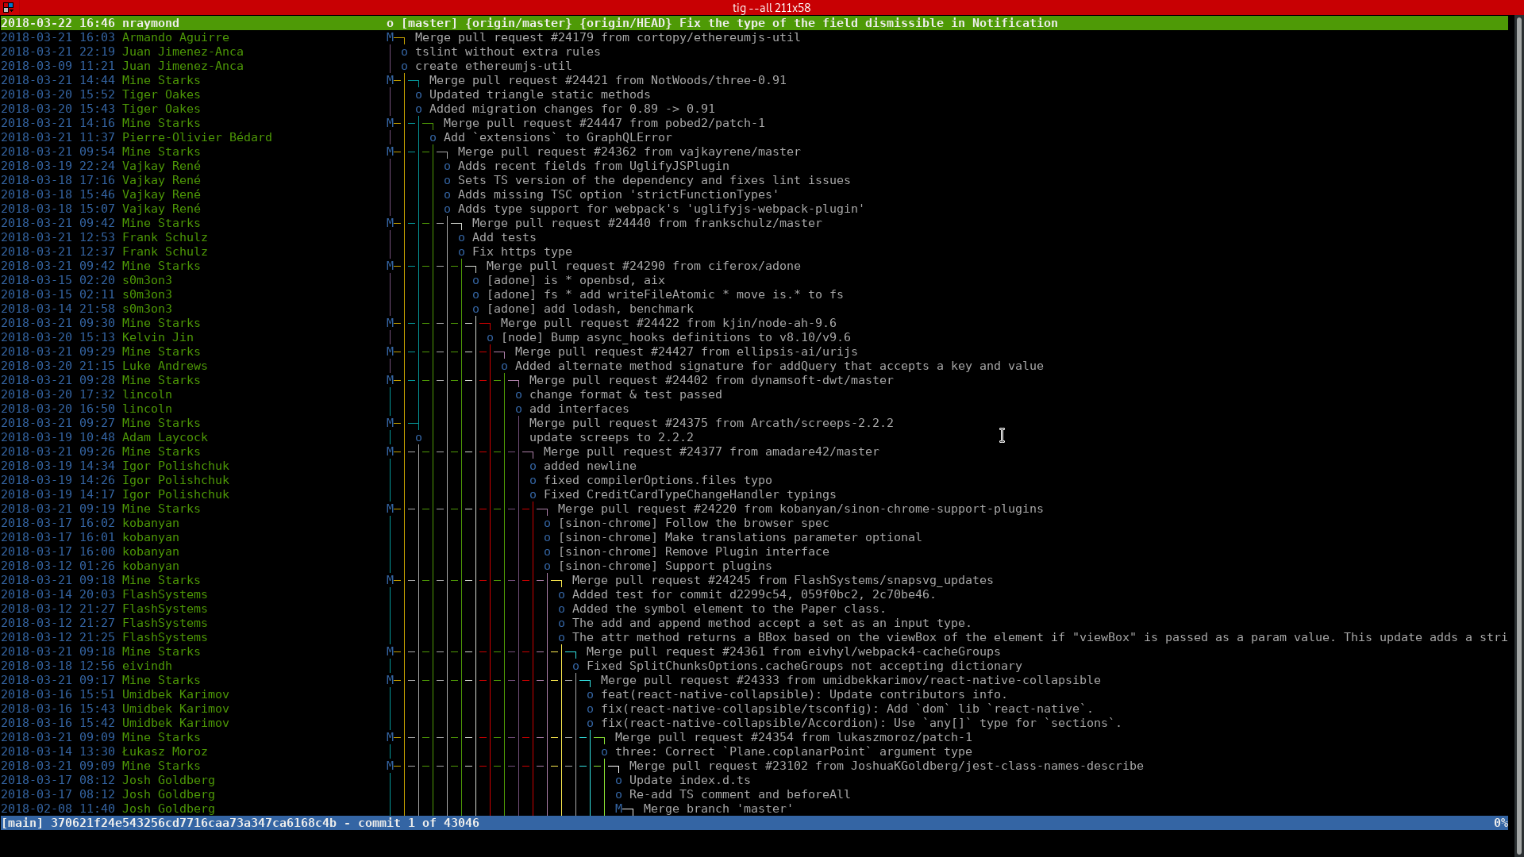
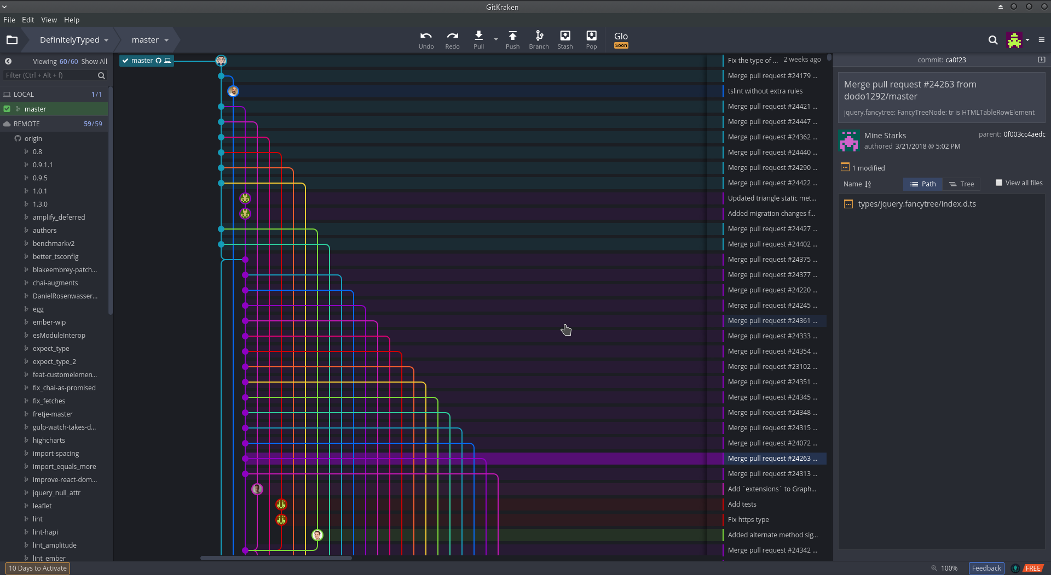
Git
Useful tools
Textual interface for git: TIG
Graphical Interface for GIT:
GitKraken, gitk, gitg...

Slide 17
Premières étapes

Slide 18
Git
Premières étapes : S’authentifier
Command Line
git config --global user.name jdoe
git config --global user.email jdoe@takima.fr
Working Directory
Working directory
my-project

Slide 19
Git
Premières étapes : Initialiser le repo
Command Line
cd my-project git init touch README.md
Working Directory
Working directory
my-project ├── .git/ └── README.md

Slide 20
Git
Premières étapes : Ajouter le README
Command Line
# Edit README.md
git add README.md
Working Directory
Working directory
my-project ├── .git/ └── README.md ++

Slide 21
Git
Premières étapes: Commit README
Command Line
Git log
commit 170bbfdbf6215fd31dd0e9df1059e79393e7438d (HEAD -> master)
Author: John Doe <jdoe@takima.fr>
Date: Thu Jan 30 12:29:15 2020 +0100
Initial commit
git commit -m “Initial commit”
Working Directory
Working directory
my-project ├── .git/ └── README.md
Git tree
* 170bbfd (HEAD -> master) Initial commit
https://www.gitignore.io/

Slide 22
Git
Premières étapes: Ignore des fichiers
Command Line
.gitignore
.idea/ *.svn .DS_Store .project .settings .classpath Thumbs.db bin target *~
# Add and edit a .gitignore file and hello class: src/Hello.java
Working Directory
Working directory
my-project ├── .git/
├── README.md ├── .gitignore └── src/
https://www.gitignore.io/

Slide 23
Git
Premières étapes: Trouver de la documentation
Command Line
.gitignore
Description
“This command updates the index using the current content found in the working tree ...“
Options
“-f, --force
Allow adding otherwise ignored files.
-i, --interactive
Add modified contents in the working tree interactively to the index...”
Configuration
“The optional configuration variable core.excludesFile indicates a path to a file containing patterns”
Example
“$ git add Documentation/\*.txt “
git add --help
⯈ git add -A
Working Directory
Working directory
my-project ├── .git/
├── README.md ├── .gitignore ++ └── src/Hello.java ++

Slide 24
Git
Premières étapes: Commit .gitignore
Command Line
Git log
git commit -m “Add gitignore and Hello class”
Working Directory
Working directory
my-project ├── .git/
├── README.md ├── .gitignore ++ └── src/Hello.java ++
Git tree
* 2d1d505 (HEAD -> master) Add gitignore...
* 170bbfd Initial commit
https://www.gitignore.io/

Slide 25
Git
Premières étapes: Git difference
Command Line
Git diff
diff --git a/src/Hello.java b/src/Hello.java
index 9b4320d..30f1f79 100644
--- a/src/Hello.java
+++ b/src/Hello.java
@@ -1,3 +1,5 @@
public class Main {
-
+ public static void main(String... args) {
+ System.out.println("Hello World !");
+ }
}
# Implement hello world class: src/Hello.java git diff
Working Directory
Working directory
my-project ├── .git/
├── README.md ├── .gitignore └── src
└── Hello.java

Slide 26
Git
Premières étapes: Add
Command Line
Git tree
* 603117b (HEAD -> master) Add hello world
* 2d1d505 Add gitignore...
* 170bbfd Initial commit
git commit -am “Add hello world”
Working Directory
Working directory
my-project ├── .git/
├── README.md ├── .gitignore └── src
└── Hello.java

Slide 27
Branches

Slide 28
Git
Branching notions:
Head Attached...
Head Detached...
master
HEAD
master
HEAD

Slide 29
Git
Branching notions
Utilise une référence qui pointe vers le commit(branch, tag, HEAD…)
Utilise le commit id
Utilise un relative acceso avec `ref~number`
(`HEAD~2` ça veut dire “2 commits avant HEAD”)
c5e824
HEAD
9f6cc8
HEAD~1 (or HEAD^)
2f999a
HEAD~2
85cc12
HEAD~3

Slide 30
Forking

Slide 31
Git
Forking
Command Line
Git log
# We will reuse the last git log
# as an example...
Working Directory
HEAD
master
B
Working directory
my-project ├── README.md └── src └── hello.java
A

Slide 32
Git
Forking: Créer une branche
Command Line
Git log
git branch feature
feature
Working Directory
B
Working directory
HEAD
master
my-project ├── README.md └── src └── hello.java
A

Slide 33
Git
Forking: Checkout une autre branche
Command Line
Git log
git checkout feature
# or “git checkout -b feature” to also create the branch
feature
Working Directory
B
Working directory
HEAD
master
my-project ├── README.md └── src └── hello.java
A

Slide 34
Git
Forking: Creer un commit sur une branche
Command Line
Git log
HEAD
feature
3
# Create feature.java file git add src/feature.java git commit -m ”1” # Create 2 more commits...
2
Working Directory
Working directory
my-project ├── README.md └── src ├── hello.java
└── feature.java
1
master
B
A

Slide 35
Git
Forking: Checkout master
Command Line
Git log
feature
3
git checkout master
2
Working Directory
Working directory
my-project ├── README.md └── src └── hello.java
1
HEAD
master
B
A

Slide 36
CI/CD
DevOps workflows made easy

Slide 37
CI/CD
CI/CD?
?

Slide 38
CI/CD
À la main
$ mvn clean install
$ npm run build
$ docker build -t super-app
$ docker push
Commit
Build
Tests
Package
Deploy
$ git commit -m “Super feature”
$ git push
$ mvn clean verify
$ npm run test
$ ssh user@IP_ADDRESS
$ docker pull super-app
$ docker rm -f super-app-ID
$ docker run super-app

Slide 39
CI/CD
À la main
Commit
Build
Tests
Package
Deploy
Lint
Quality Gate
Tests E2E
$ npm run lint
$ mvn sonar:sonar
$ selenium-runner

Slide 40



Continuous Integration and Continuous Delivery
Automate your problems away
With Github
Travis CI
SonarCloud

Slide 41
CI/CD
Avant CI/CD
Lent cycle de releases
Des semaines voir des mois …
Perte de temps
Conflits le jour du “merge day”
Des bugs à résoudre
Tester/deployer manuellement

Slide 42


CI/CD
Avant CI/CD
Continuous Integration (CI)
Regular integration => PR et merge
Build/tests automatisés
Continuous Delivery/Deployment (CD)
Mettre les artefacts sur un repo
Automatique déploiement en production
Continuous
Integration
Continuous
Delivery
Continuous
Deployment
Commit
Build
Tests
Package
Deploy
Repository
Server

Slide 43
CI/CD
Pour et Contre
?

Slide 44
CI/CD
Pour et Contre
Releases fréquentes et plus facile
Constant feedback
Rapide découverte de bugs
Plus de temps pour se consacrer aux bugs
Besoin d’une mentalité DevOps
Un temps initial de setup

Slide 45
CI/CD
Outils
Travis CI
Jenkins
Gitlab CI
Circle CI
...

Slide 46
Intro to Github & Travis CI

Slide 47
CI/CD
Introduction
Github
Fondé en 2008 - @Microsoft 2018
Git repository manager
Github Enterprise
Travis CI
(!) Pas gratuit pour les repo privés
(!) Seulement Github
Linux, macOS & Windows

Slide 48
CI/CD
Pourquoi Travis CI ?
Full Github integration
Simple installation
Declarative configuration
Open source
Full Github integration
Des features payants
Pas gratuits pour les repo privés

Slide 49
Travis CI

Slide 50


CI/CD
Comment ça marche?
Dockerhub
4. Publish
1. Push
2. Trigger job
5. Deploy
3. Build
Developer
Github
Travis
Error: Alert
SonarCloud

Slide 51
CI/CD
Comment ça marche?
phase - les étapes d’un job (install, script, deploy)
job - un processus qui clone ton repo dans un environnement virtuel et qui réalise une série de phases
build - un groupe de jobs.
stage - un groupe de jobs qui run en parallèle.

Slide 52
CI/CD
.travis.yml
language: java
cache:
directories:
- "$HOME/.m2/repository"
- "$HOME/.sonar/cache"
services:
- docker
before_install:
- docker pull postgres:9.6
- docker run -d -p 5432:5432 postgres
script:
- mvn clean install
notifications:
email:
on_failure: always
deploy:
provider: script
script: ssh -i /tmp/travis_deploy_rsa $USER@$SERVER" sudo docker pull $IMAGE_NAME:$TAG && sudo docker rm -f app || true && sudo docker run -d --network net -p 80:8080 --name app $IMAGE_NAME:$TAG"
on:
branch: master
Notes:
1 job

Slide 53
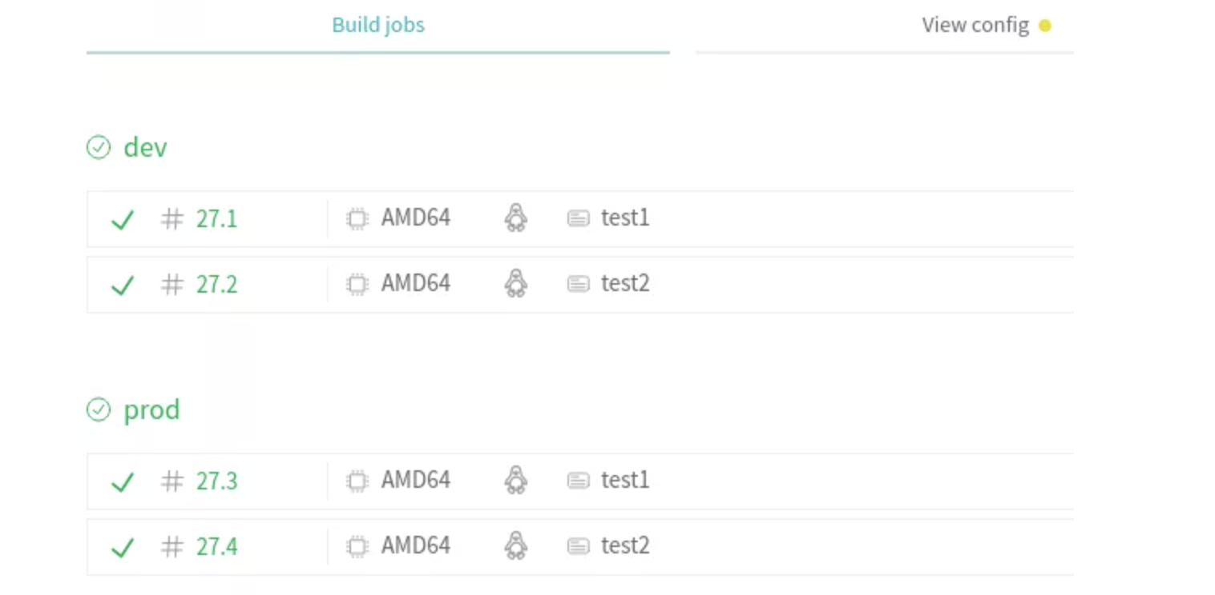
CI/CD
Stages
language: java
stage:
- dev
- prod
jobs:
include:
- stage: dev
name: test1
script: echo "hello world from dev1"
- script: echo "hello world from dev2"
name: test2
- stage: prod
name: test1
script: echo "hello world from prod1"
- script: echo "hello world from prod2
name: test2

Slide 54
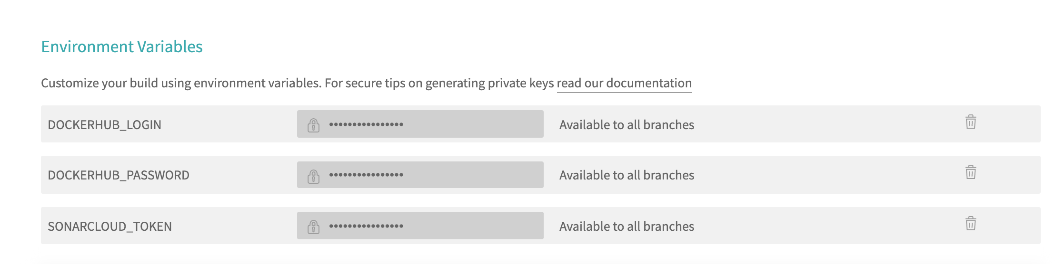
CI/CD
Secrets et variables

Slide 55
Sonar Cloud

Slide 56
CI/CD
Dette technique
Deadline
Total
Tech
Debt
Unmanaged
Managed
Time

Slide 57
CI/CD
SonarCloud: qualité
Analyse de qualité
20+ different languages
Test coverage & execution
Vérification des bugs & code smells
Et plus encore

Slide 58
Docker
Take Away
CI/CD automatise tout du commit à la mise en prod
Travis est une bonne option mais n’est pas la seule
Ne pas mettre de donnée sensible dans ton travis.yml
Utiliser un outil de qualité de code

Slide 59
Enough speaking.
Take me to the code !
http://bit.ly/2Mkmazd
TD02 - git & Github

